Slide 1

Tittle: Little Loves Shopping
Course : Web Development
Instructor : Dr.Casturi Rao
Yasaswini Kandru
Biswas Vempati

Slide 2
Introduction
Online shopping is a form of electronic commerce whereby consumers directly buy goods or services from a seller over the internet without an intermediary service
It process whereby consumers directly buy goods or services from a seller in real-time, without an intermediary service, over the Internet.

Slide 3
Advantages of Online Shopping
Disadvantages of Online Shopping
Shop 24/7
Comfort of own home
A lot of stores within a click away
Comparison Shopping easier
Delay in the delivery
Hidden costs and shipping charges
Lack of interaction
Frauds in online shopping

Slide 4

Frontend Framework’s Used
HTML
CSS
jQuery
Bootstrap

Slide 5

Database and Scripting languages used
MySQL
SQL
PHP

Slide 6
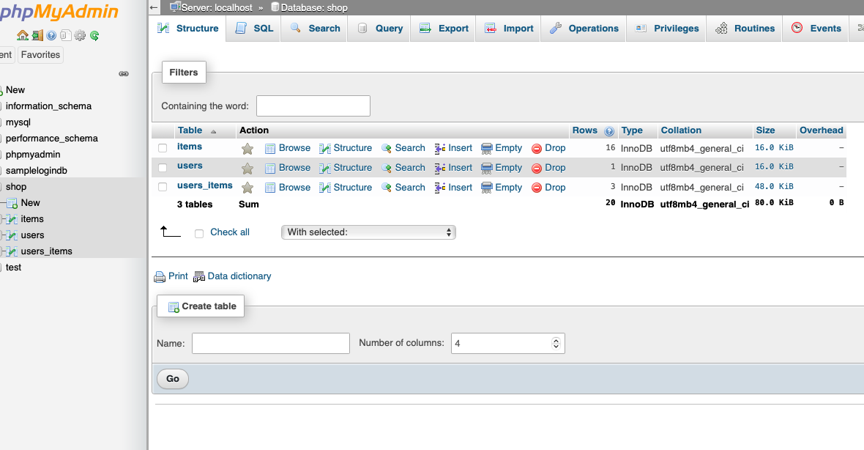

Slide 7
Modules Involved
Login
Items Gallery
Cart
User Registration
Logout

Slide 8
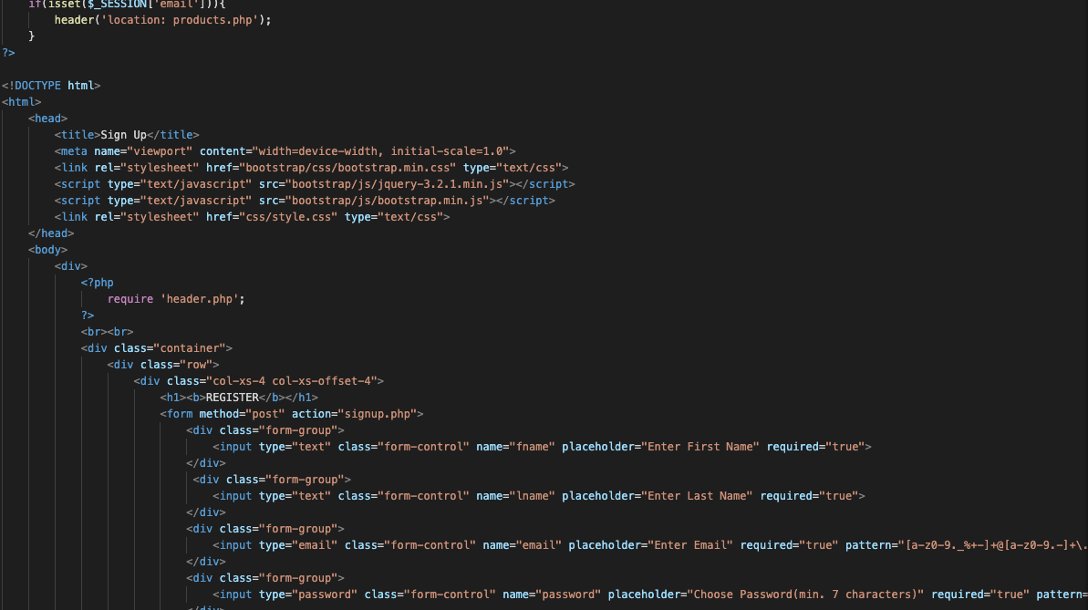
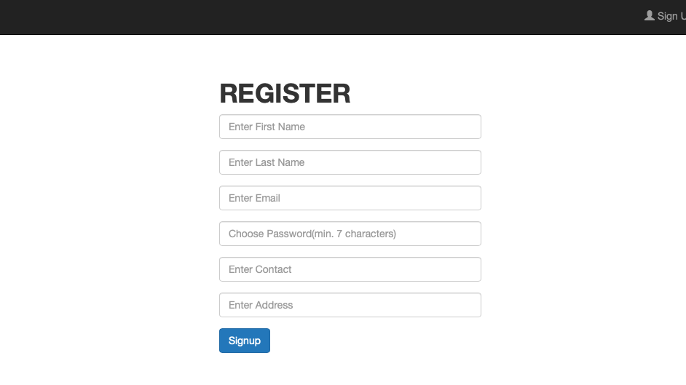
User Registration

Slide 9
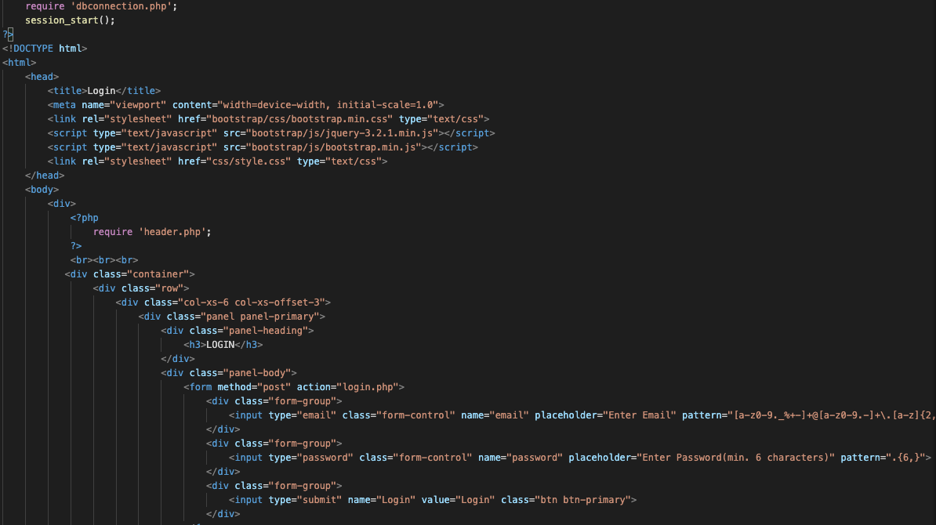
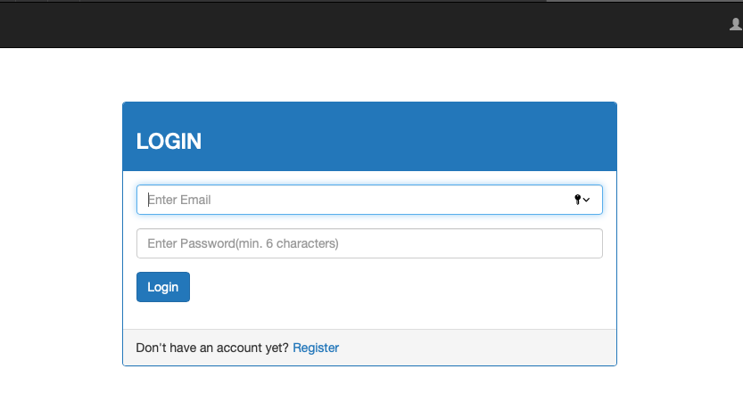
Login Page

Slide 10
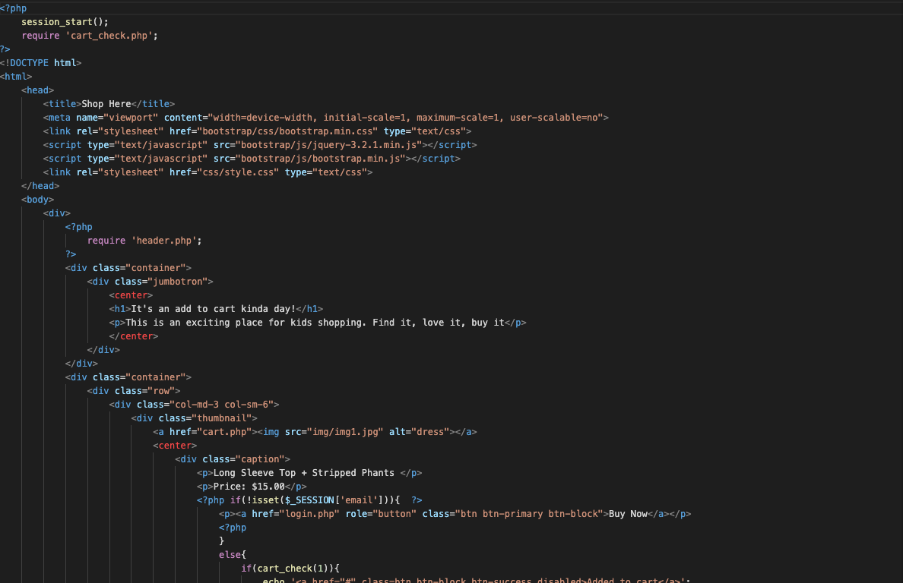
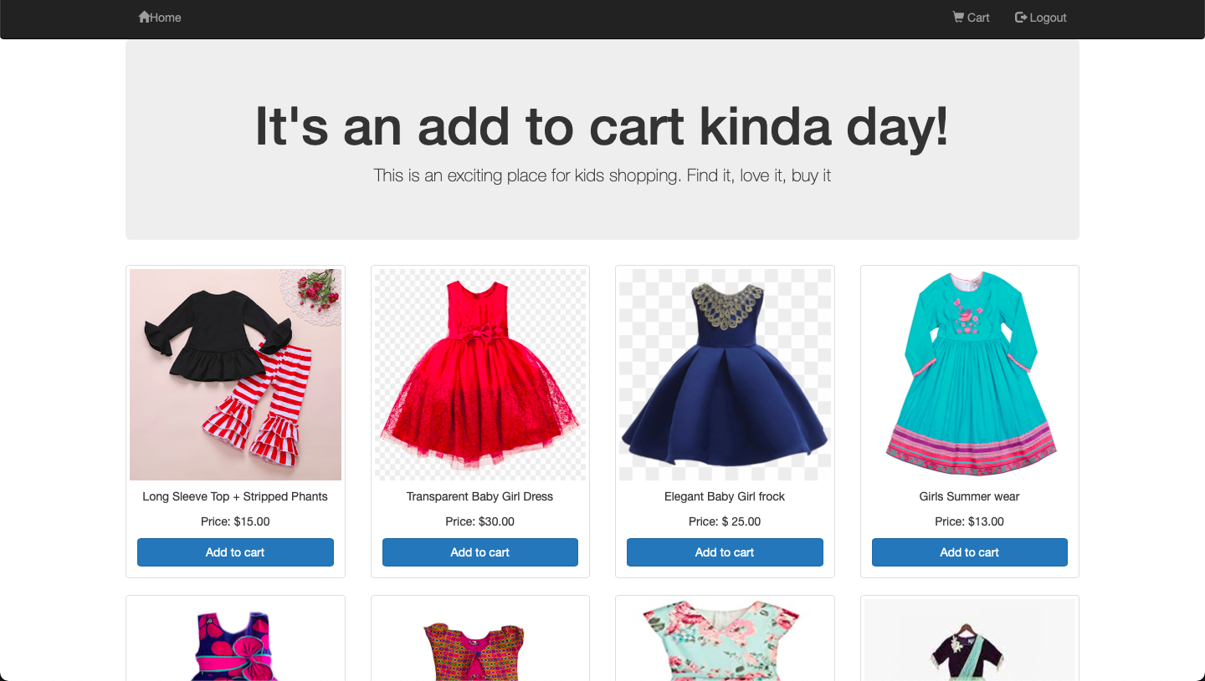
Items Gallery

Slide 11
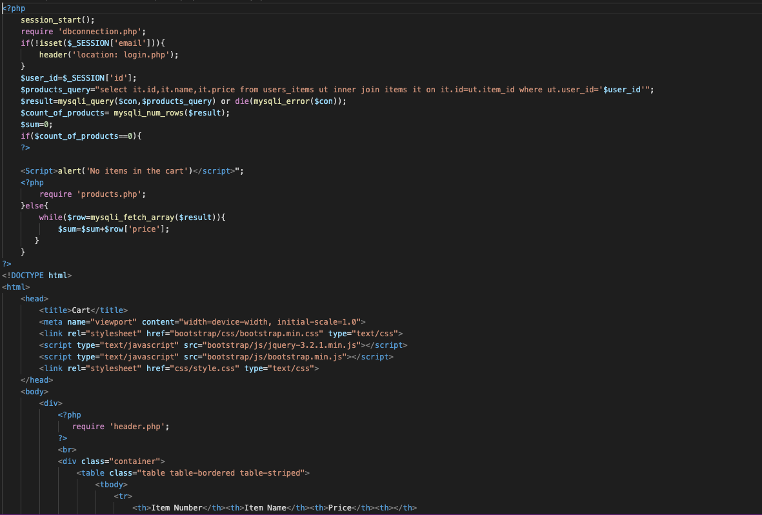
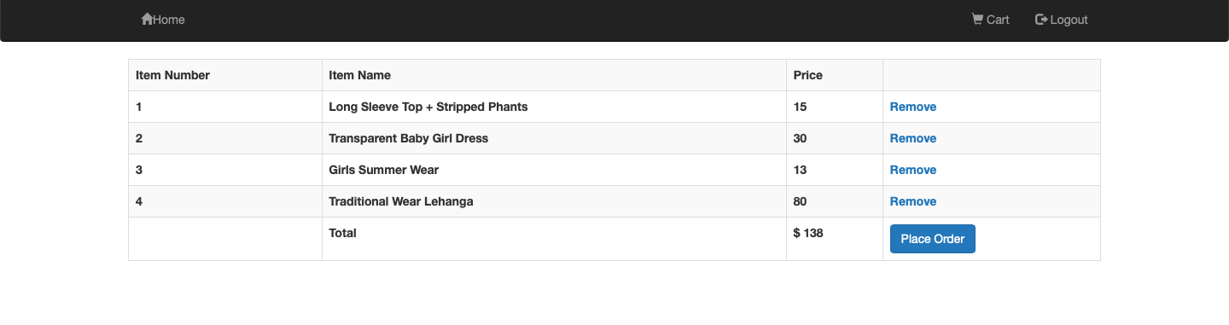
Cart

Slide 12
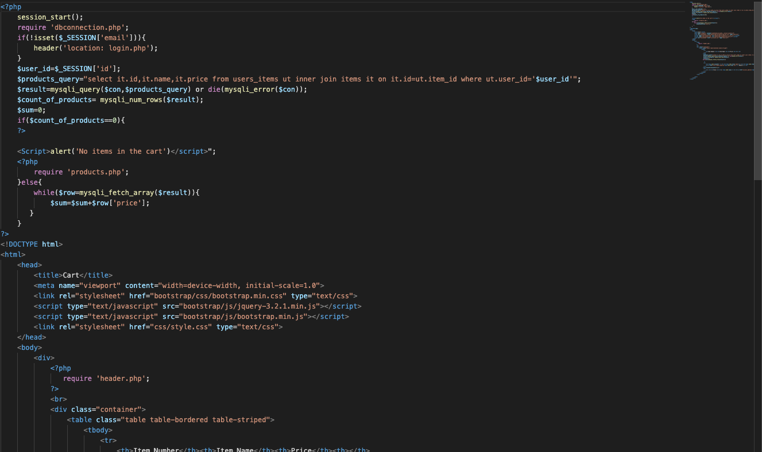
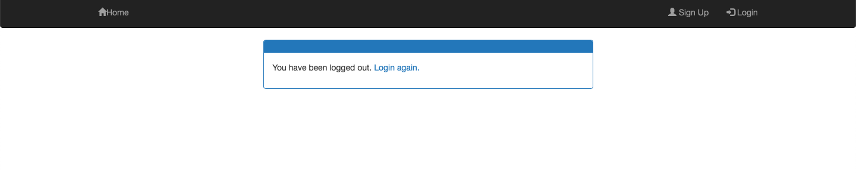
Logout

Slide 13
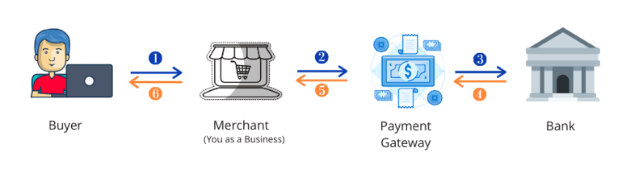
Future Improvements
In future we plan to add payment gateway to our application

Slide 14

Thankyou

